Slide 1

Unit - III Introduction to ARM Cortex-M3
Reference:
Yiu, Joseph, The Definitive Guide to ARM® Cortex®-M3 and Cortex®-M4 Processors, Newnes, Elsevier Inc., 3rd Edition, 2013

Slide 2
Introduction to ARM Cortex
ARM extended its product portfolio by diversifying its CPU development, which resulted in the architecture version 7 or v7.
In this version, the architecture design is divided into three profiles:
• The A profile: high-performance open application platforms.
• The R profile: high-end embedded systems with real-time performance.
• The M profile: deeply embedded microcontroller-type systems.
A Profile (ARMv7-A): Application processors designed to handle complex applications such as high-end embedded operating systems Eg: mobile phones and e- wallets.
R Profile (ARMv7-R): Real-time, high-performance processors targeted at higher end of the real-time market. Eg: high-end breaking systems and hard drive controllers, in which low latency is important.
M Profile (ARMv7-M): Processors targeting low-cost applications in which processing efficiency is important cost, power consumption, low interrupt latency, and ease of use are critical, as well as industrial control applications, including real-time control systems.

Slide 3
Evolution of ARM Processor Architecture
With version 7 of the architecture, ARM has migrated away from these complex numbering schemes that needed to be decoded2
For example, the ARM7TDMI is not a v7 processor but was based on the v4T architecture
A synthesizable core design is available in the form of a hardware description language (HDL) such as Verilog or VHDL and can be converted into a design netlist using synthesis software

Slide 4
Instruction Set Development
Historically (since ARM7TDMI), two different instruction sets are supported on the ARM processor:
ARM instructions that are 32 bits and Thumb instructions that are 16 bits.
During program execution, the processor can be dynamically switched between the ARM state and the Thumb state to use either one of the instruction sets.
The Thumb instruction set provides only a subset of the ARM instructions, but it can provide higher code density.
It is useful for products with tight memory requirements.
In 2003, ARM announced the Thumb-2 instruction set, which is a new superset of Thumb instructions that contains both 16-bit and 32-bit instructions.

Slide 5
Instruction Set Development
Focused on small memory system devices such as microcontrollers and reducing the size of the processor, the Cortex-M3 supports only the Thumb-2 (and traditional Thumb) instruction set
Instead of using ARM instructions for some operations, as in traditional ARM processors, it uses the Thumb-2 instruction set for all operations.
As a result, the Cortex-M3 processor is not backward compatible with traditional ARM processors.
A binary image for ARM7 processors cannot run on the Cortex-M3 processor.
Nevertheless, the Cortex-M3 processor can execute almost all the 16-bit Thumb instructions, including all 16-bit Thumb instructions supported on ARM7 family processors, making application porting easy.

Slide 6
Cortex – M3 Features
The Cortex™-M3 is a 32-bit microprocessor.
It has a 32-bit data path, a 32-bit register bank, and 32-bit memory interfaces
The processor has a Harvard architecture, it has a separate instruction bus and data bus.
This allows instructions and data accesses to take place at the same time
The performance of the processor increases because data accesses do not affect the instruction pipeline
The instruction and data buses share the same memory space (a unified memory system)
The Cortex-M3 processor includes a number of fixed internal debugging components such as breakpoints and watchpoints

Slide 7
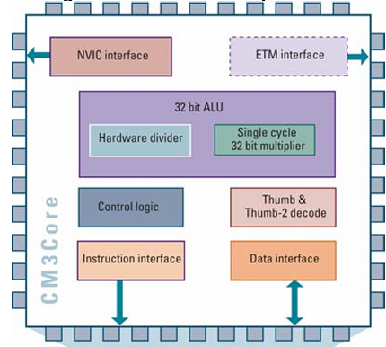
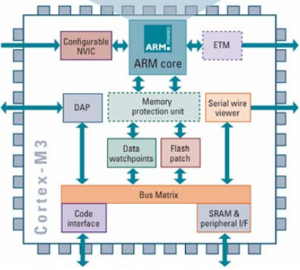
Cortex – M3 Architecture

Slide 8
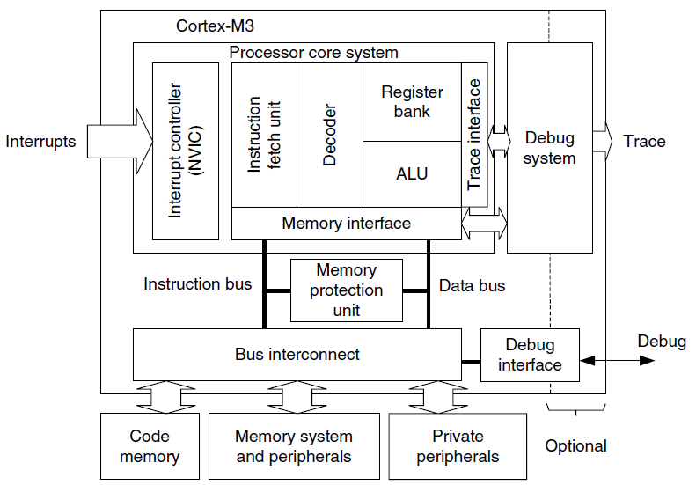
Cortex – M3 Architecture
Optional components provide debugging features, such as instruction trace, and various types of debugging interfaces

Slide 9
Operational Modes
Thread mode:
Used to execute application software.
The processor enters Thread mode when it comes out of reset.
In Thread mode, the CONTROL register controls whether software execution is privileged or unprivileged
Handler mode:
Used to handle exceptions.
The processor returns to Thread mode when it has finished all exception processing
In Handler mode, software execution is always privileged.

Slide 10
Operational Modes
Unprivileged:
• The software has limited access to the MSR and MRS instructions, and cannot use the CPS instruction
• Cannot access the system timer, NVIC, or system control block
• Might have restricted access to memory or peripherals.
Unprivileged software executes at the unprivileged level.
Privileged:
The software can use all the instructions and has access to all resources.
Privileged software executes at the privileged level
Only privileged software can write to the CONTROL register to change the privilege level for software execution in Thread mode.
Unprivileged software can use the SVC instruction to make a supervisor call to transfer control to privileged software.

Slide 11
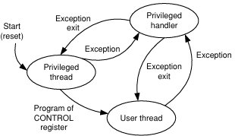
Operational Modes

Slide 12
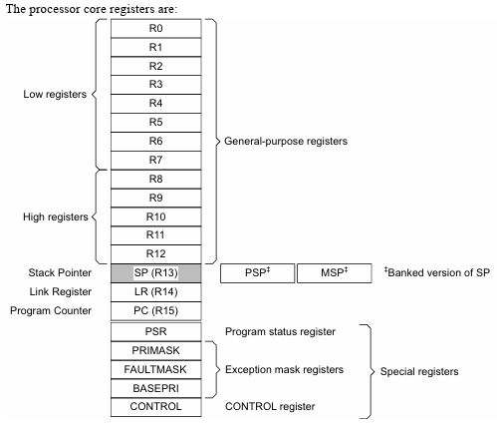
Core Registers

Slide 13
Core Registers
General-purpose registers: R0-R12 are 32-bit registers for data operations.
Stack Pointer: The Stack Pointer (SP) is register R13.
In Thread mode, bit[1] of the CONTROL register indicates the stack pointer to use:
• 0 =Main Stack Pointer (MSP). This is the reset value.
• 1 =Process Stack Pointer (PSP).
On reset, the processor loads the MSP with the value from address 0x00000000.
Link Register: The Link Register (LR) is register R14.
It stores the return information for subroutines, function calls, and exceptions.
On reset, the processor sets the LR value to 0xFFFFFFFF.
Program Counter: The Program Counter (PC) is register R15.
It contains the current program address.
On reset, the processor loads the PC with the value of the reset vector, which is at address 0x00000004.
Bit[0] of the value is loaded into the EPSR T-bit at reset and must be 1.

Slide 14
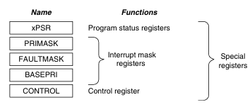
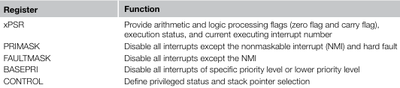
Special Registers
The Cortex-M3 processor also has a number of special registers
They are as follows:
• Program Status registers (PSRs)
• Interrupt Mask registers
(PRIMASK, FAULTMASK, and BASEPRI)
• Control register (CONTROL)
These registers are mutually exclusive bitfields in the 32-bit PSR.
These registers have special functions and can be accessed only by special instructions.
They cannot be used for normal data processing

Slide 15
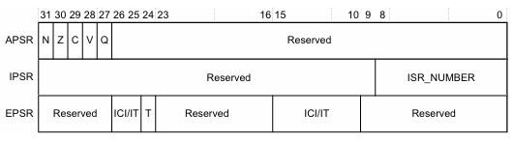
Special Registers: Program Status Registers
The Program Status Register (PSR) combines:
• Application Program Status Register (APSR)
• Interrupt Program Status Register (IPSR)
• Execution Program Status Register (EPSR).
These registers are mutually exclusive bitfields in the 32-bit PSR.
The bit assignments are:

Slide 16
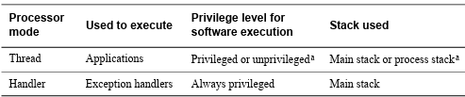
Stacks
The processor uses a full descending stack.
This means the stack pointer holds the address of the last stacked item in memory.
When the processor pushes a new item onto the stack, it decrements the stack pointer and then writes the item to the new memory location.
The processor implements two stacks, the main stack and the process stack, with a pointer for each held in independent registers
In Thread mode, the CONTROL register controls whether the processor uses the main stack or the process stack
In Handler mode, the processor always uses the main stack

Slide 17
Data Types
The processor supports the following data types:
— 32-bit words
— 16-bit halfwords
— 8-bit bytes.
• manages all data memory accesses as little-endian or big-endian.
Instruction memory and PPB accesses are always performed as little-endian.

Slide 18
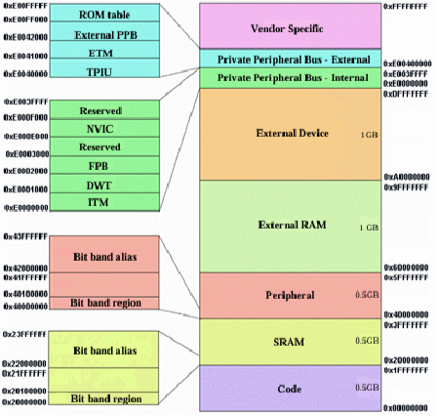
Cortex-M3 Memory Map

Slide 19
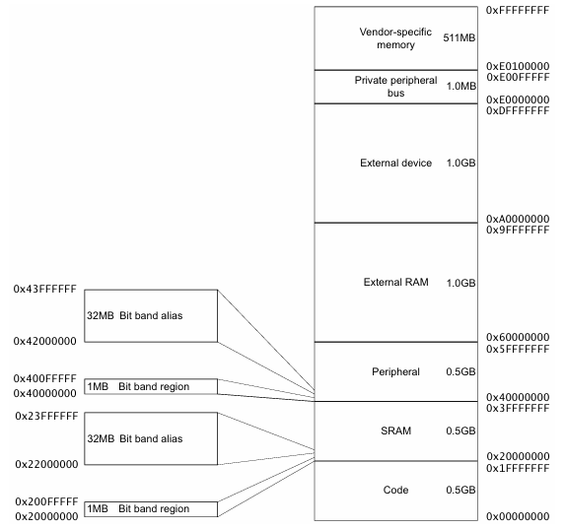
Cortex-M3 Memory Map

Slide 20
Bit Banding
The following formula shows how the alias region maps onto the bit-band region:
bit_word_offset = (byte_offset x 32) + (bit_number x 4)
bit_word_addr = bit_band_base + bit_word_offset
where:
Bit_word_offset is the position of the target bit in the bit-band memory region.
Bit_word_addr is the address of the word in the alias memory region that maps to the
targeted bit.
Bit_band_base is the starting address of the alias region.
Byte_offset is the number of the byte in the bit-band region that contains the targeted bit
Bit_number is the bit position, 0-7, of the targeted bit.
The alias word at 0x23FFFFE0 maps to bit[0] of the bit-band byte at 0x200FFFFF: 0x23FFFFE0 = 0x22000000 + (0xFFFFF*32) + (0*4).
• The alias word at 0x23FFFFFC maps to bit[7] of the bit-band byte at 0x200FFFFF: 0x23FFFFFC = 0x22000000 + (0xFFFFF*32) + (7*4).

Slide 21
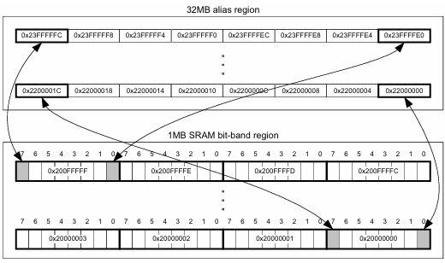
Bit Banding
• The alias word at 0x22000000 maps to bit[0] of the bitband byte at 0x20000000: 0x22000000 = 0x22000000 + (0*32) + (0 *4).
- • The alias word at 0x2200001C maps to bit[7] of the bit-band byte at 0x20000000: 0x2200001C = 0x22000000+ (0*32) + (7*4)

Slide 22
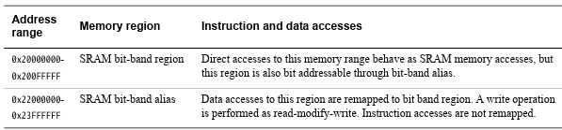
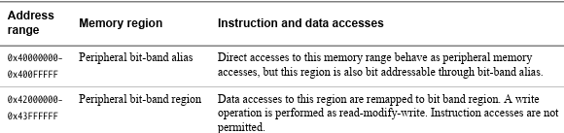
Bit Banding
A bit-band region maps each word in a bit-band alias region to a single bit in the bit-band region.
The bit-band regions occupy the lowest 1MB of the SRAM and peripheral memory regions.
The memory map has two 32MB alias regions that map to two 1MB bit-band regions:
accesses to the 32MB SRAM alias region map to the 1MB SRAM bit-band region
accesses to the 32MB peripheral alias region map to the 1MB peripheral bit-band region

Slide 23
Power Management
The Cortex-M3 processor sleep modes reduce power consumption
They might do one or all of the following:
• sleep mode stops the processor clock
• deep sleep mode stops the system clock and switches off the PLL and flash memory.
If your device implements two sleep modes providing different levels of power saving, the SLEEPDEEP bit of the SCR selects which sleep mode is used

Slide 24
Power Management – Entering Sleep Mode
Wait For Interrupt (WFI):
WFI instruction, causes immediate entry to sleep mode unless the wake-up condition is true
Wait For Event (WFE):
WFE instruction, causes entry to sleep mode depending on the value of a one-bit event register.
checks the value of the event register:
0 - Processor stops executing instructions and enters sleep mode.
1 - Processor clears register to 0 & continues executing instructions without entering sleep mode.
Event bit is set when external event signal is asserted, or a processor in the system has executed an SEV instruction
Software cannot access this register directly
Sleep-on-exit:
If the SLEEPONEXIT bit of the SCR is set to 1, when the processor completes the execution of all exception handlers it returns to Thread mode and immediately enters sleep mode.
Use this mechanism in applications that only require the processor to run when an exception occurs.

Slide 25
Power Management – Wakeup from Sleep Mode
The conditions for the processor to wakeup depend on the mechanism that cause it to enter sleep mode.
Wakeup from WFI or sleep-on-exit:
Normally, the processor wakes up only when it detects an exception with sufficient priority to cause exception entry
Wakeup from WFE:
The processor wakes up if:
• it detects an exception with sufficient priority to cause exception entry
• it detects an external event signal
• in a multiprocessor system, another processor in the system executes an SEV instruction.
The processor, even if the interrupt is disabled or has insufficient addition, if the SEVONPEND bit in the SCR is set to 1, any new pending interrupt triggers an event and wakes up nt priority to cause exception entry
Wakeup Interrupt Controller (WIC):
Optional Peripheral, not programmable, operates from hardware signals
Device might include a WIC, that can detect an interrupt and wake the processor from deep sleep mode.
The WIC is enabled only when the DEEPSLEEP bit in the SCR is set to 1

Slide 26
Cortex Microcontroller Software Interface Standard (CMSIS)
CMSIS defines:
a common way to: access peripheral registers & define exception vectors
• the names of: the registers of the core peripherals & the core exception vectors
• a device-independent interface for RTOS kernels, including a debug channel.
The CMSIS includes address definitions and data structures for the core peripherals in the Cortex-M3 processor.
CMSIS simplifies software development by enabling the reuse of template code and the combination of CMSIS-compliant software components from various middleware vendors.
Software vendors can expand the CMSIS to include their peripheral definitions and access functions for those peripherals.

